Slide 1

Using custom image targets in Vuforia

Slide 2

Creating a Vuforia account
The creation of a custom image target database for Vuforia is done through the Vuforia website
As such, it requires the creation of a Vuforia account (free for basic functionalities)
Go to https://developer.vuforia.com/
Click “Register” (top right) to create an account

Slide 3
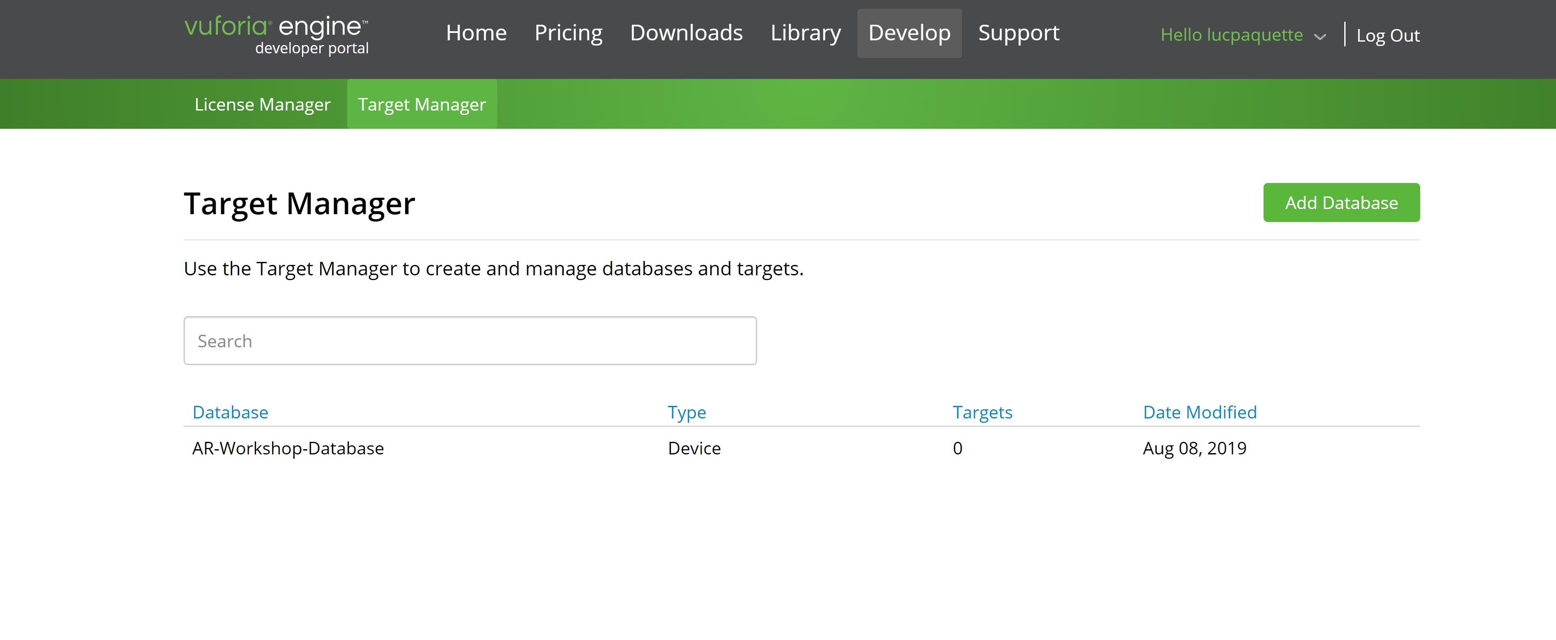
Creating a database
Click on “Target Manager” and select “Add Database”

Slide 4
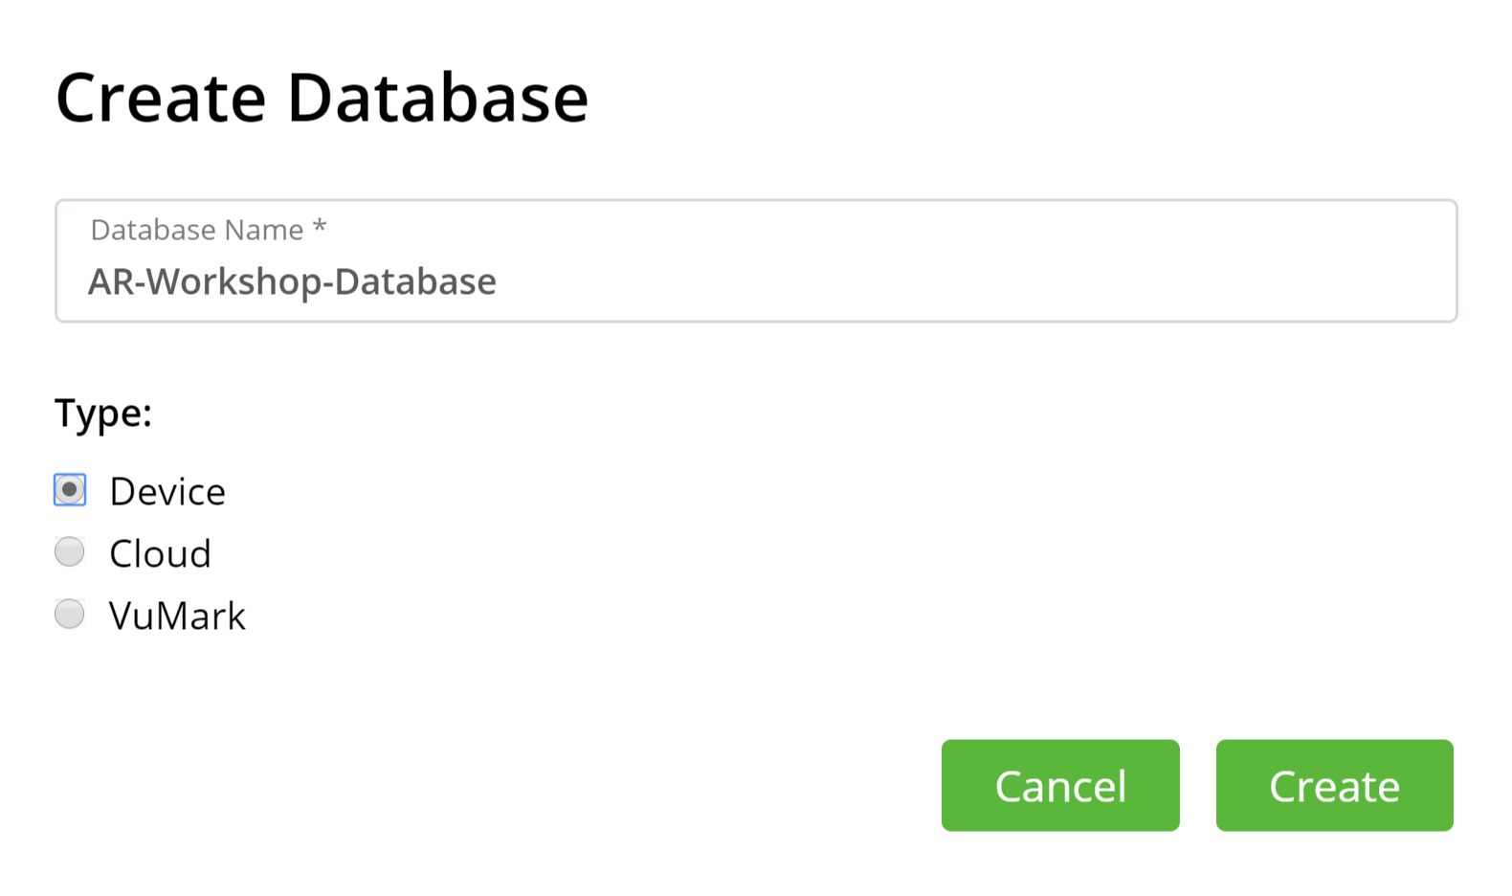
Creating a database
Enter a name for your database, select “Device” as the database type’s and click “Create”

Slide 5
Creating a database
Select your database by clicking on it

Slide 6
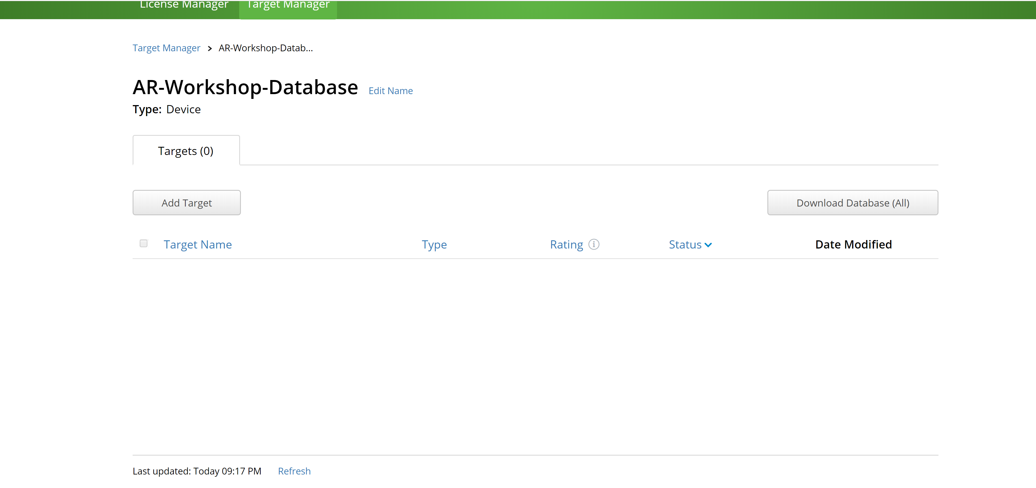
Adding an image target
Click the “Add target” button

Slide 7
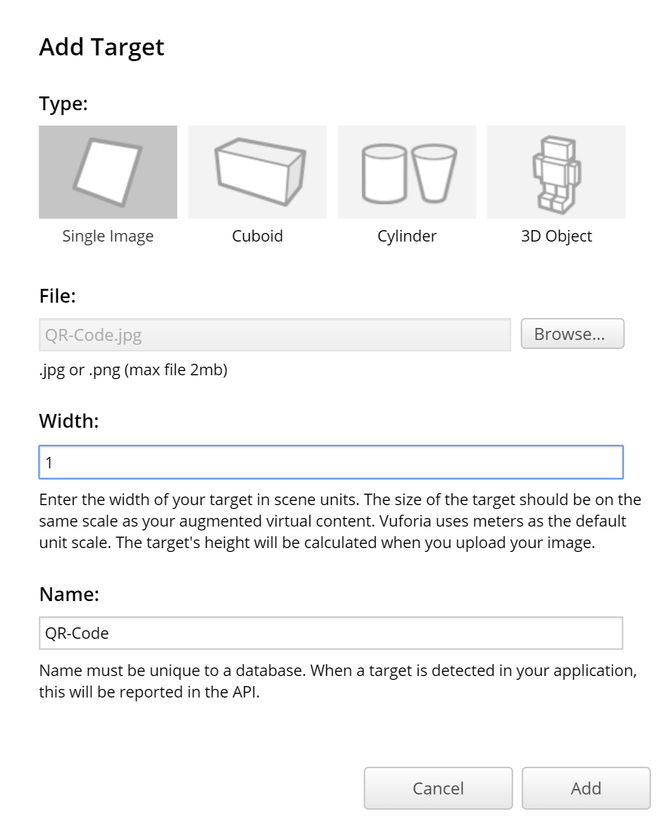
Adding an image target
Select “Single Image” as the type
Use the “Browse…” button to select the image file
Enter a width for the target
This value is arbitrary and determines the size of the target when loaded in Unity
In my tests, smaller values have worked better, but this might be dependent on your project
You can always rescale the target in your project
Enter a name for your target
Click “Add” in the lower right corner

Slide 8
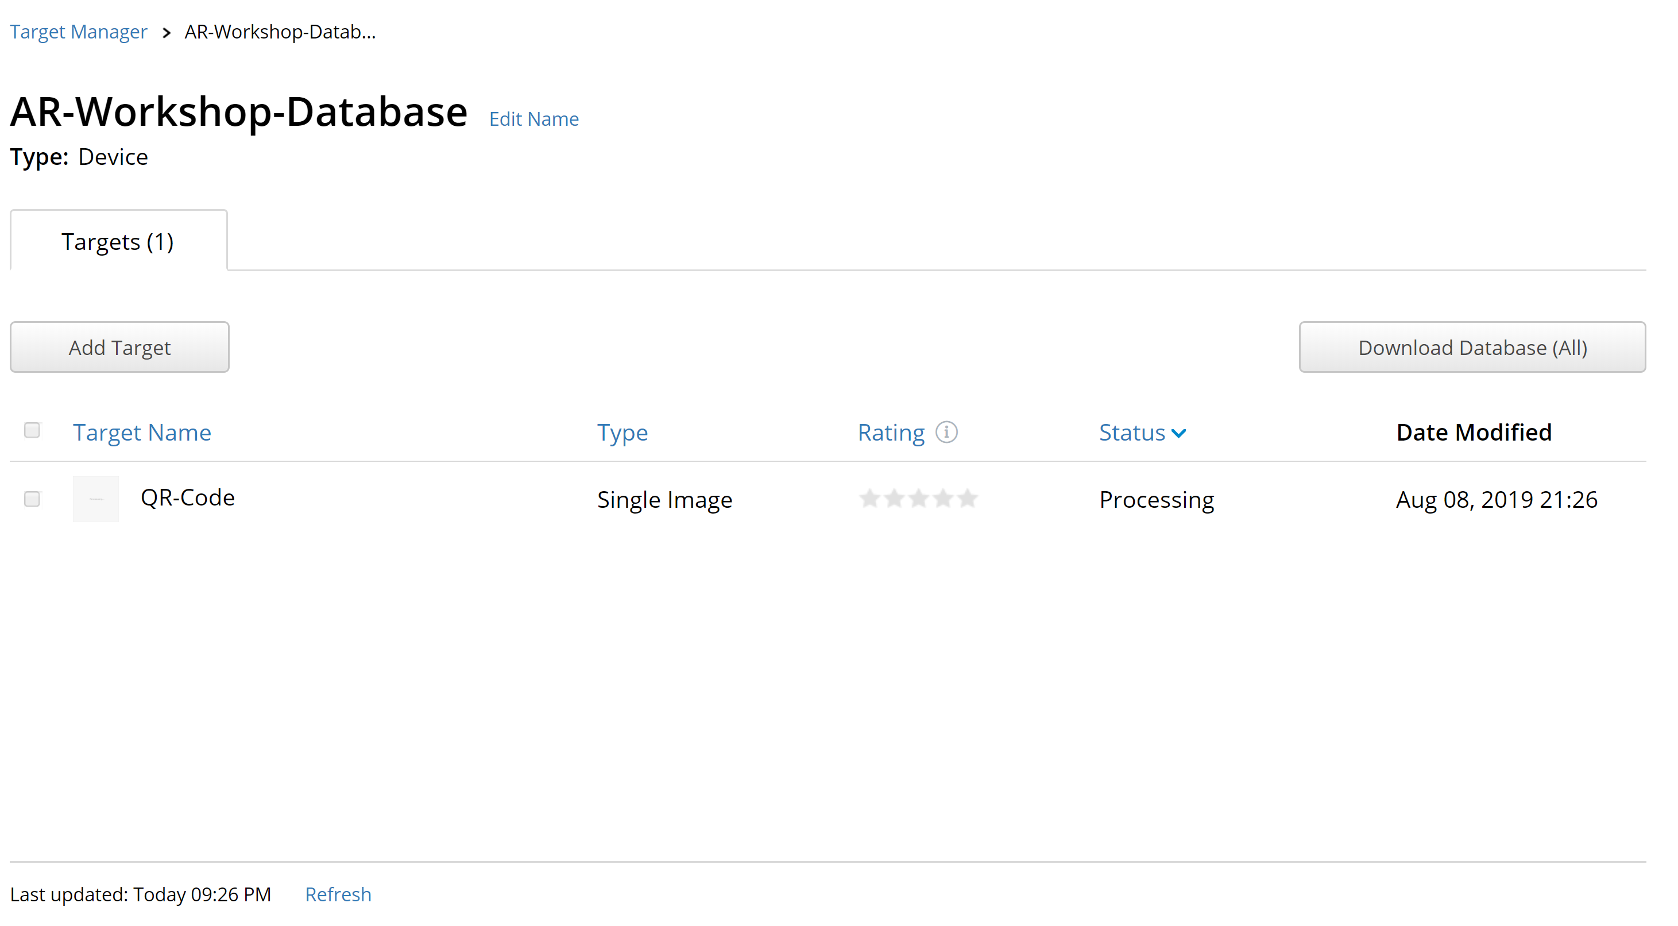
Adding an image target
The Vuforia website will process the image
Details will be added after the processing is over (you can refresh the page to see if the processing is completed

Slide 9
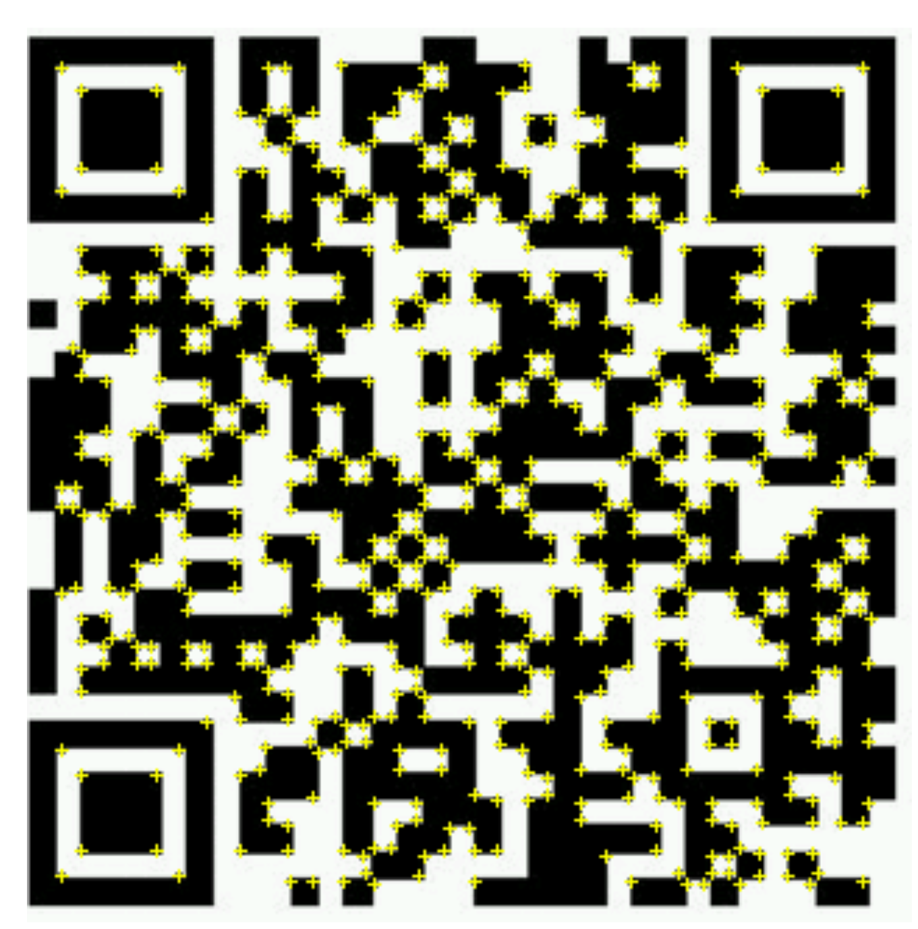

Adding an image target
Vuforia will compute features to be able to detect the image

Slide 10
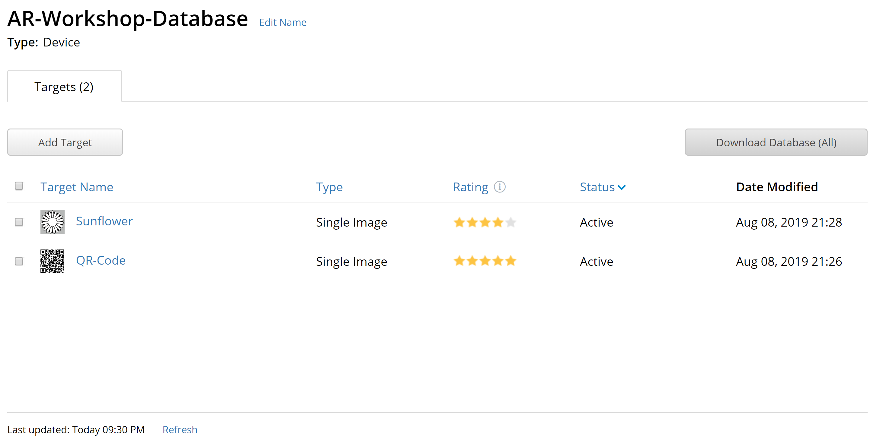
Importing the database in Unity
Click the “Download Database (All)” button

Slide 11
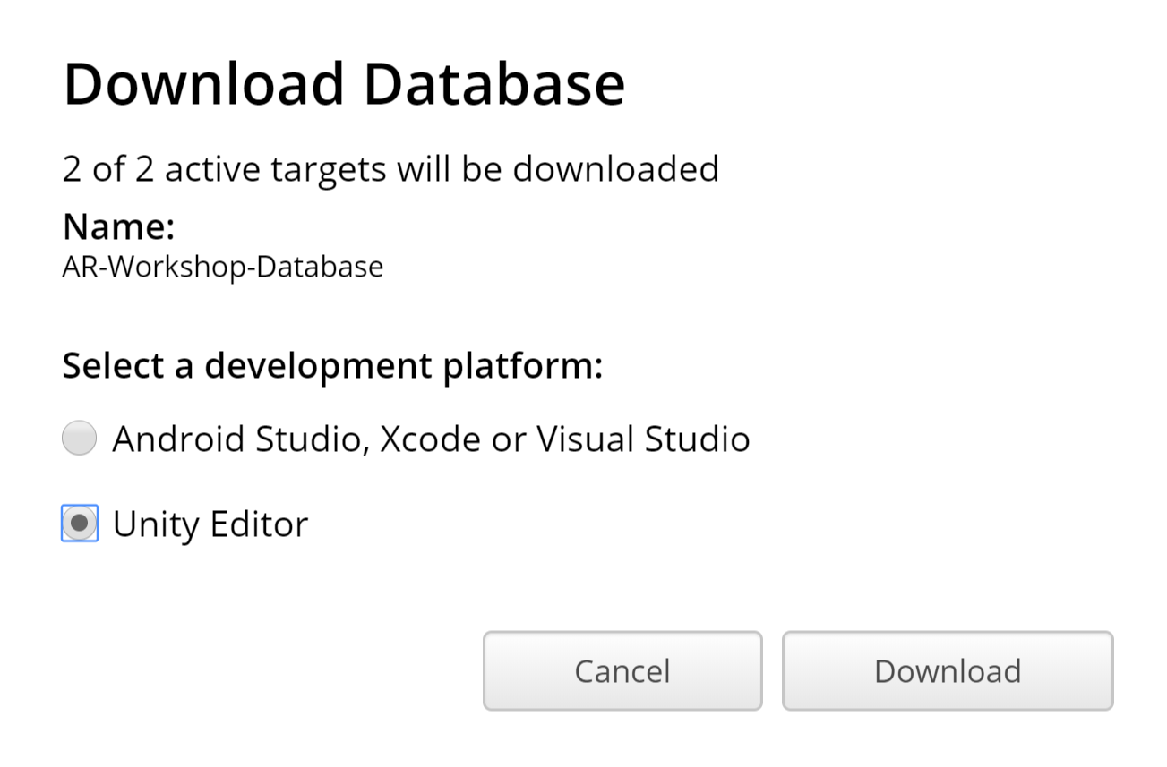
Importing the database in Unity
Select “Unity Editor” and click the “Download” button

Slide 12
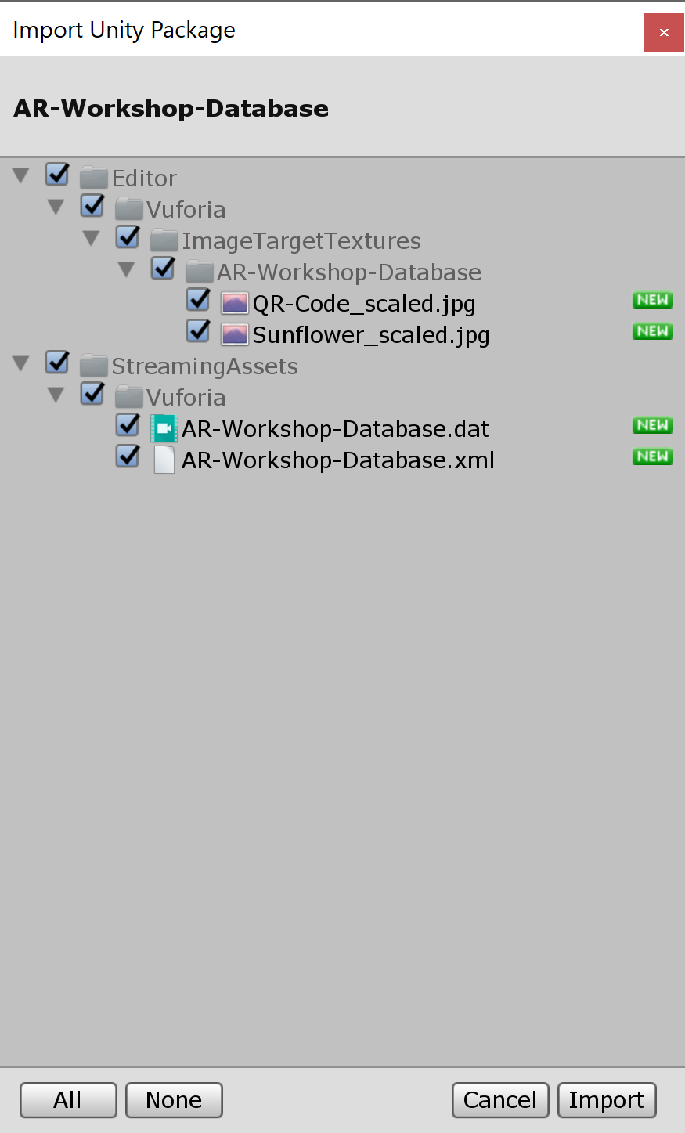
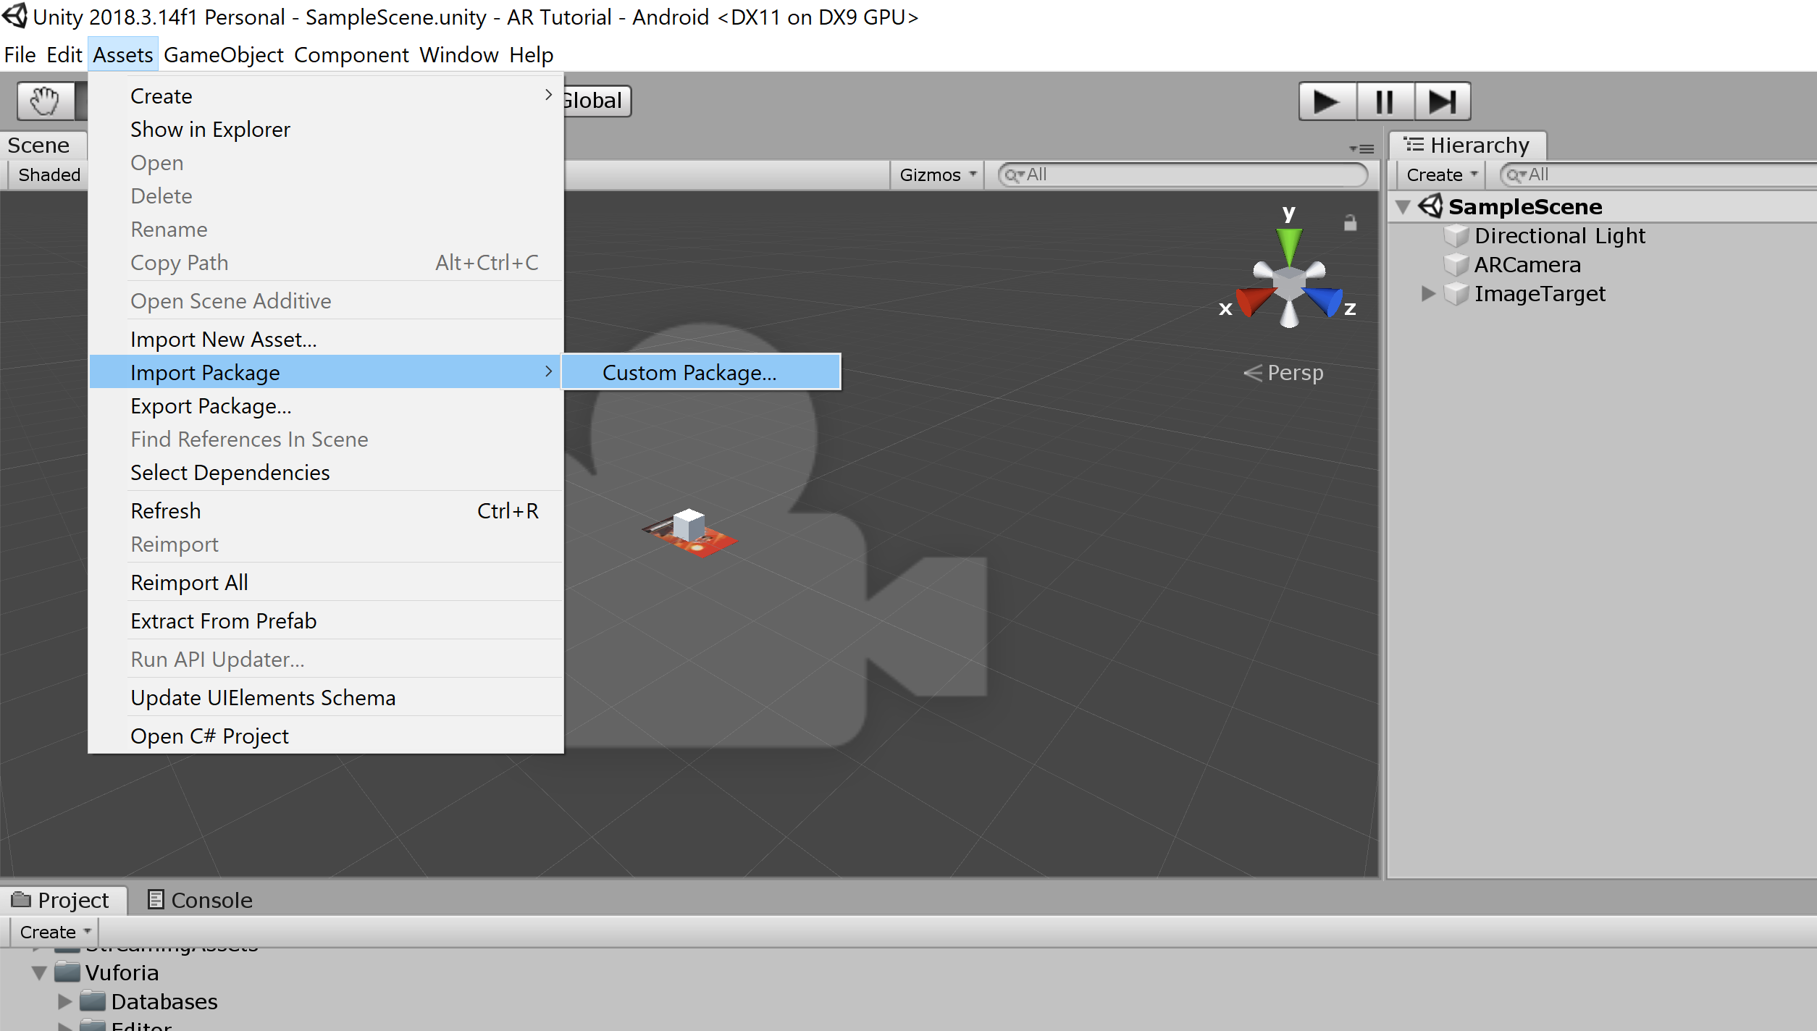
Importing the database in Unity
In Unity, select “Assets → Import Package → Custom Package…”
Select your database
Import all the assets

Slide 13
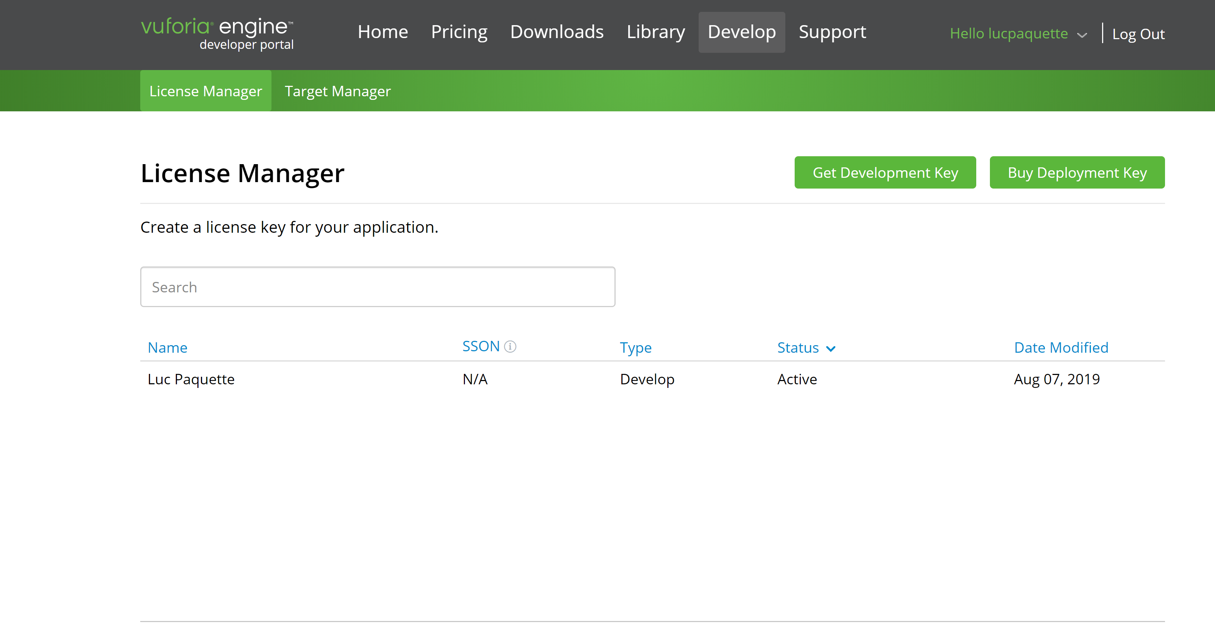
Creating and using your Vuforia license
On the Vuforia website, select the “License Manager”
Click “Get Development Key” to create your key

Slide 14
Creating and using your Vuforia license
Click on your license to view your key

Slide 15
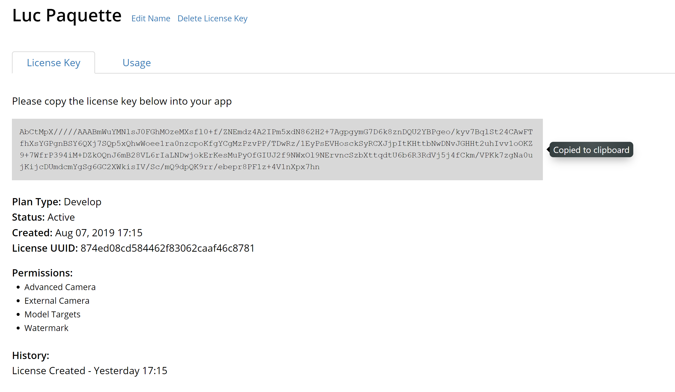
Creating and using your Vuforia license
Click on the key to copy it to your clipboard

Slide 16
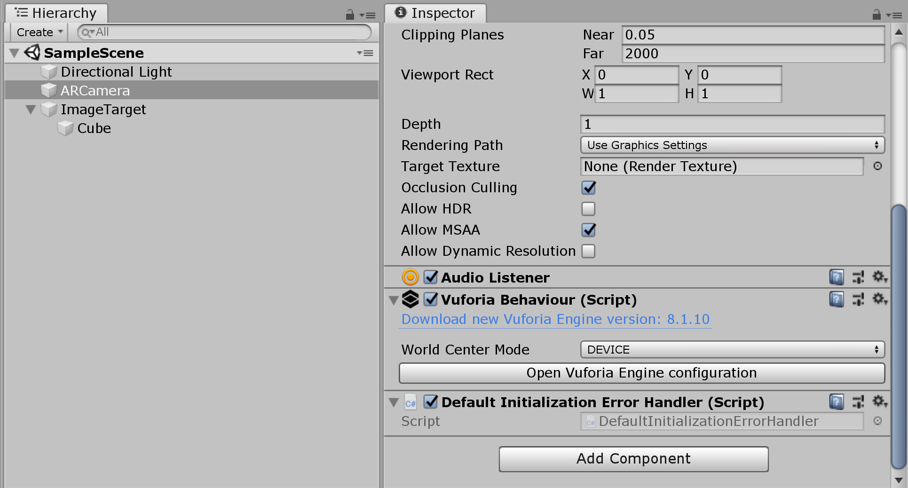
Creating and using your Vuforia license
In Unity
Select your AR Camera in the hierarchy window
Find the “Open Vuforia Engine Configuration” button in the Inspector

Slide 17
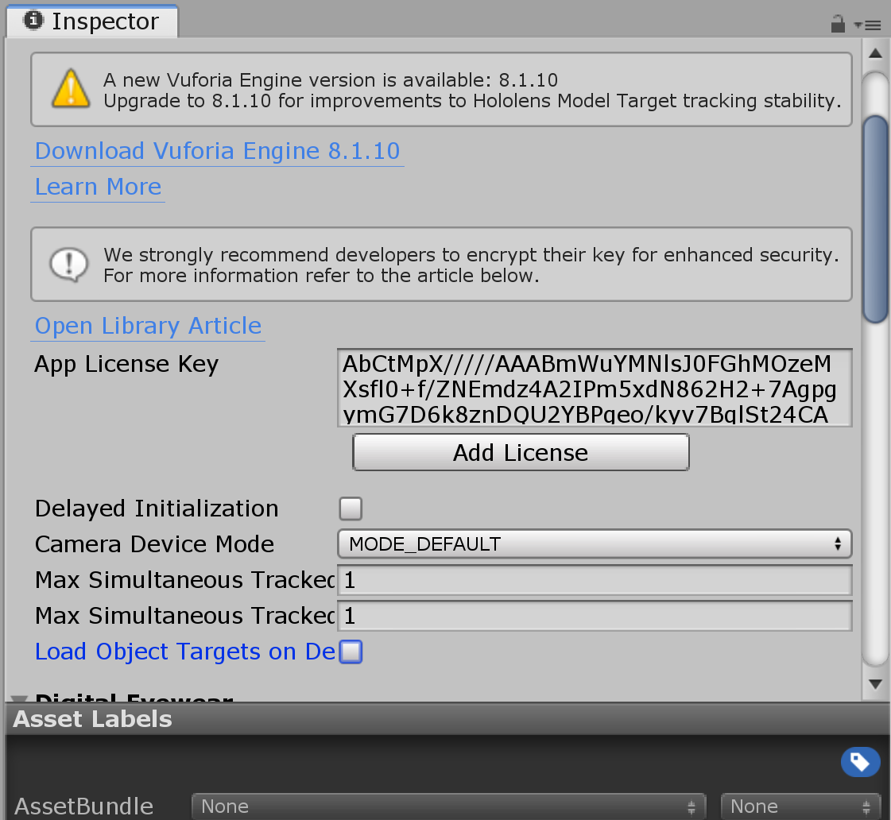
Creating and using your Vuforia license
Paste your license key in the “App License Key” field

Slide 18
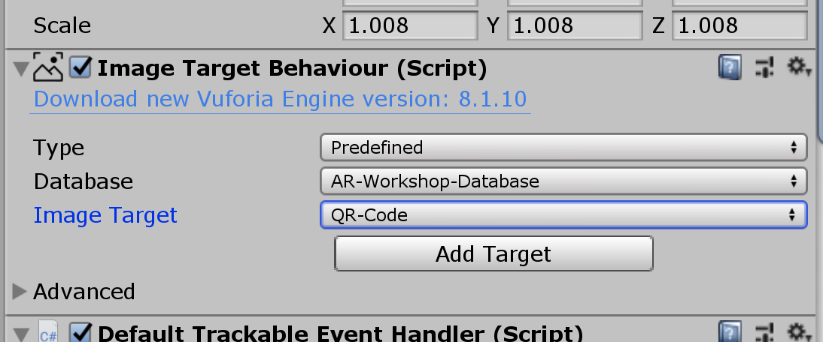
Using the custom image target
Select your image target in the hierarchy
In the inspector, modify the “Image Target Behavior” component
Select your database
Select the image you want to use as target

